Slide 1



Bapuji Institute of Engineering and Technology, Davanagere- 577004
Department of Computer Science and Engineering
Presentation on
Departmental Alumni Network Platform
4BD21CS023
4BD21CS010
4BD21CS007
4BD21CS020
Team Associate details
BHAVANA S
AMRUTHA M BANAKAR
AKASH B NAIK
ANUSHREE BASAVARAJ KUPPAST
Project guide : Project Co-Ordinator:
Prof. Raghu B R
Assistant Professor
Department of CS&E
Prof.Shankar Sarji P
Assistant Professor
Department of CS&E

Slide 2

CONTENTS
1.Introduction
2.Objectives
3.Project Idea of Execution
4.Methodology
5.Tools and Technologies
6.Features of the project
7.Snapshots
8.Learning Outcomes
9.Conclusion

Slide 3
Introduction
Alumni networks are vital for career advancement, offering access to job opportunities, mentorship, and professional growth.
This platform encourages continuous engagement, allowing alumni to stay connected with their alma mater ,students and with institution.
This platform also serves as a vital link between current students and alumni, enabling valuable networking opportunities.
By facilitating mentorship and job opportunities, it prepares students for their professional journeys.

Slide 4
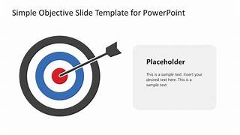
Objectives:
To create a user-friendly platform that is intuitive for both students and alumni.
To provide features for students to offer and seek mentorship and job opportunities from alumni.
To create a platform to enable the organization and promotion of networking events.
To access guidance to students and support from experienced professionals, improving career readiness.
To encourage alumni to stay connected and contribute to their community.

Slide 5



Project Idea of Execution
Software Development: Leveraged ReactJS for a dynamic front-end, ensuring a seamless user experience with quick load times and interactive features.
Utilized SQL for data management, enabling efficient storage and retrieval of user profiles and activity logs.
Networking: This project facilitate easy communication between users through messaging features and profile searches.

Slide 6
Methodology
Planning:
We began with a comprehensive planning phase, outlining the project scope and objectives, identifying user requirements for mentorship and job opportunities.
Determining the necessary features for the admin, student, and alumni login pages.
Development:
The development process involved using HTML, CSS, and React.js for the frontend to create an engaging user interface.
For the backend, we utilized SQL, deploying the platform on a XAMPP server to handle data management and server functionalities.

Slide 7
Testing:
Implemented unit and integration testing to ensure each component functions as intended.
Conducted user testing sessions to gather feedback on usability and overall experience.
Documentation:
Comprehensive documentation was created, detailing the architecture, codebase, and user guides.
This ensures that future developers can understand and maintain the system, and provides users with the necessary information to navigate the platform effectively.

Slide 8
Tools and Technologies
Programming Languages
HTML: Structure the content of the web application, providing the foundational layout.
CSS: Style the application, ensuring a visually appealing and user-friendly interface.
ReactJS: Used for building a dynamic and responsive frontend
SQL: Manage and query the database, handling data related to users, job postings, and events , XAMPP server for local development and testing.

Slide 9

Features of the Project
1. User Authentication
Login Pages:
Separate login interfaces for Admin, Students, and Alumni.
Secure authentication to protect user data.
2. User Profiles
Custom Profiles:
Alumni can create profiles and can highlight their professional experience and areas of expertise.
3. Mentorship Program
Mentor-Mentee Matching:
Connect students with alumni based on their interests and goals.
Easy search and filter options to find suitable alumni.
4. Job Opportunities
Job Board:
Students can browse and apply for jobs relevant to their field of study.

Slide 10

5. Networking Events
Event Calendar:
Promote upcoming networking events, workshops, and seminar.
6. Admin Panel
Admin Controls:
Manage user accounts (students and alumni).
Oversee job postings and event management.

Slide 11
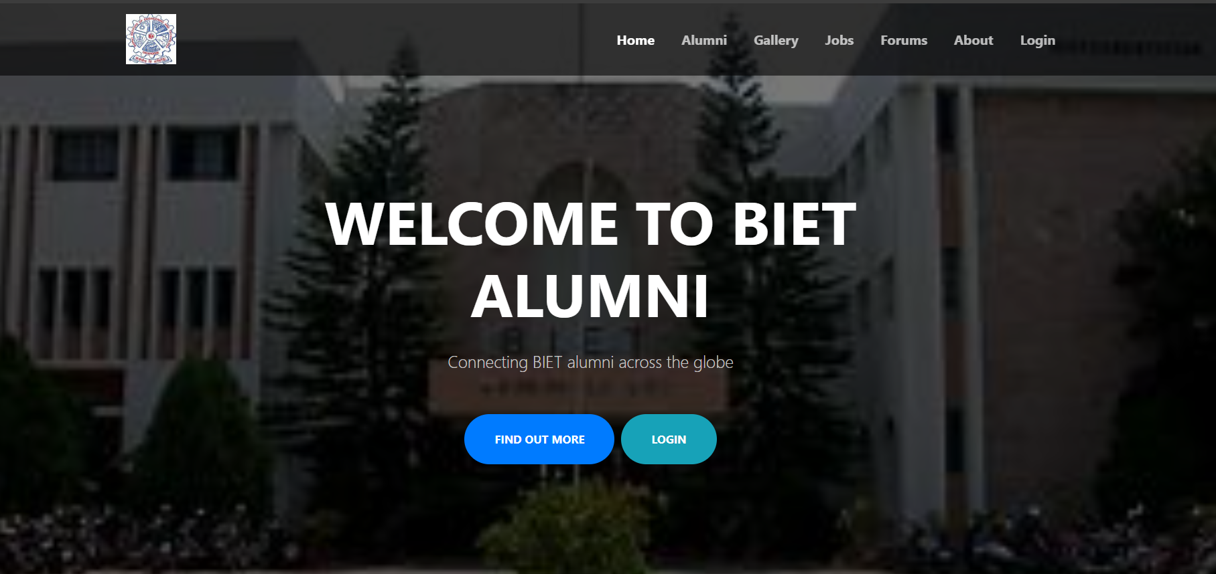
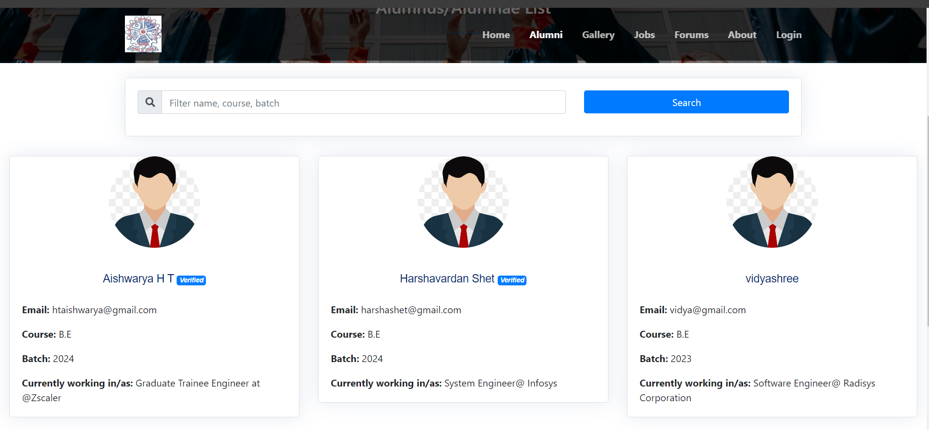
Snapshots
Fig: Home page
Fig: Alumni page

Slide 12
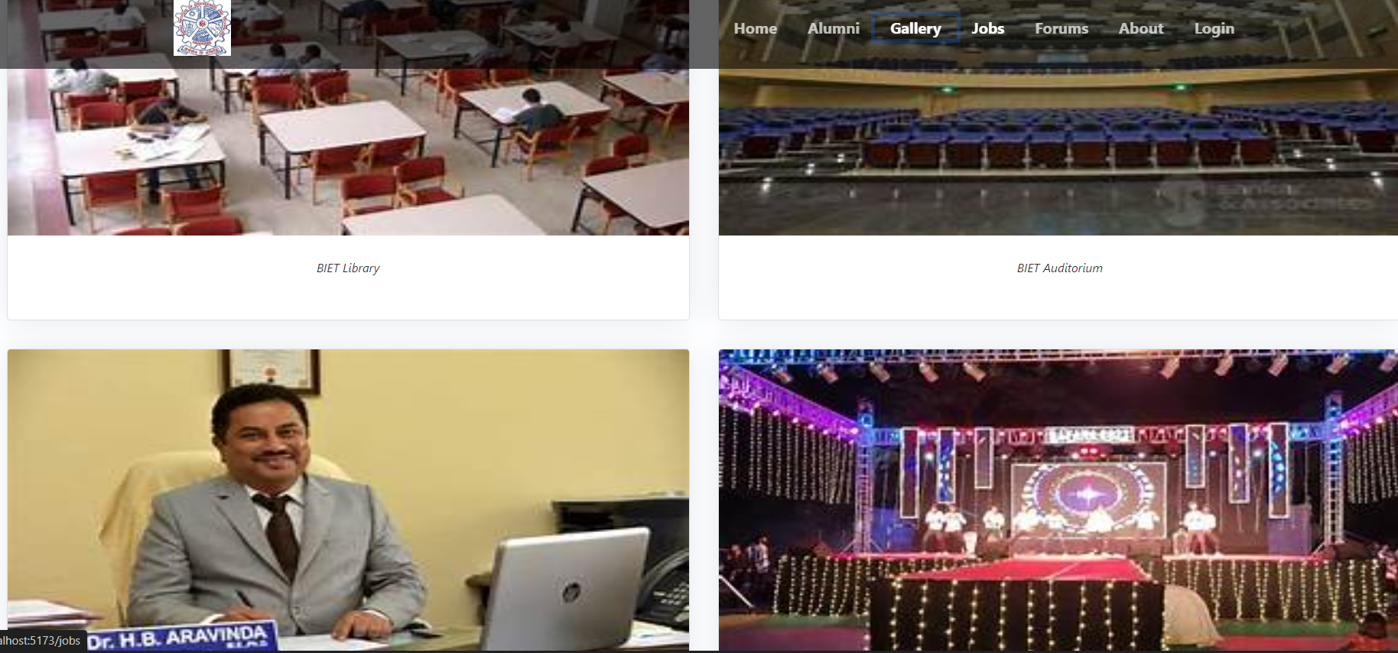
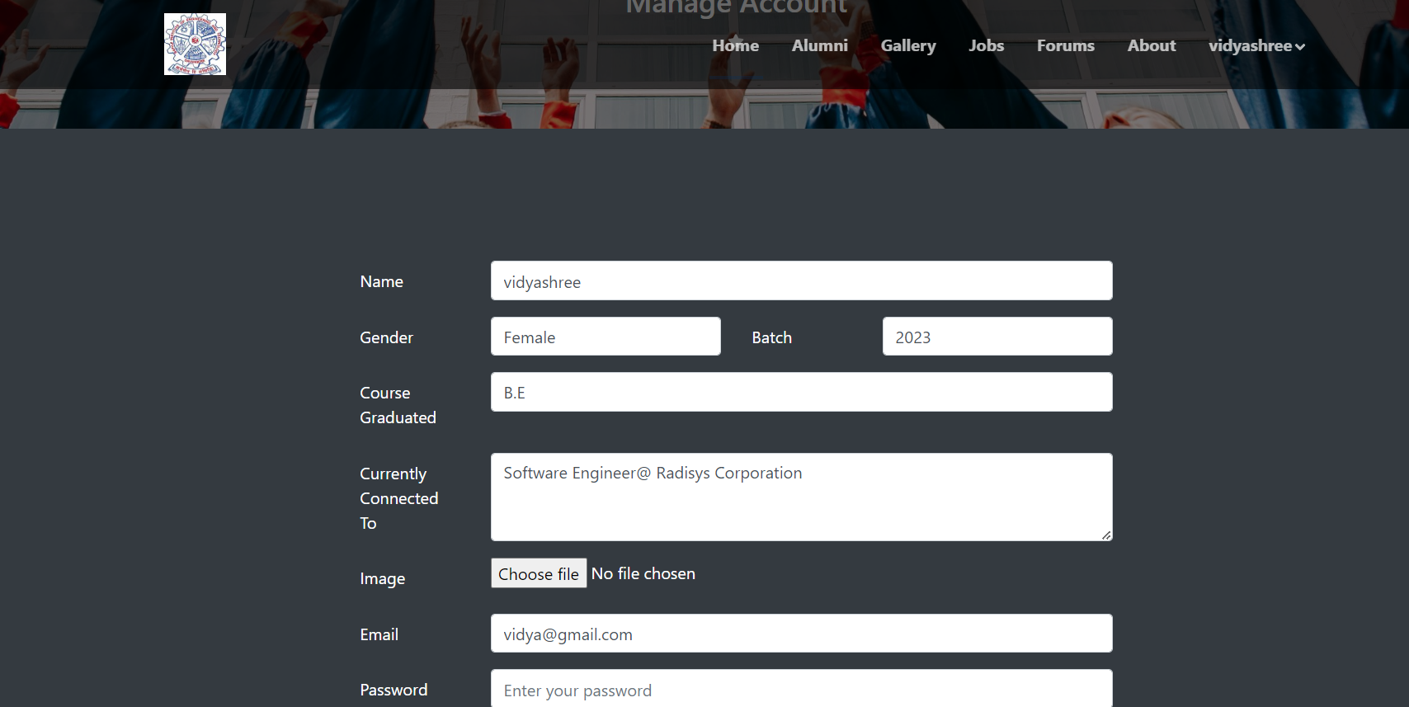
Fig: Gallery page
Fig: Alumni edit profile page

Slide 13
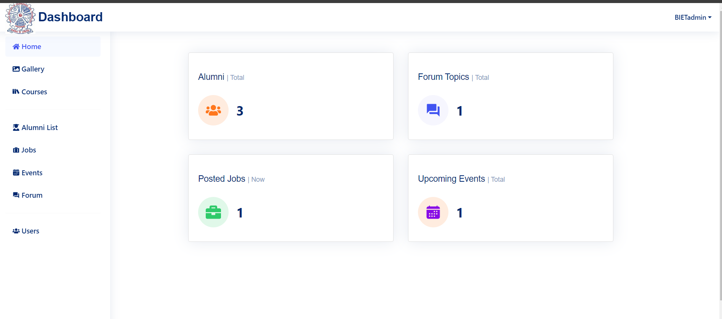
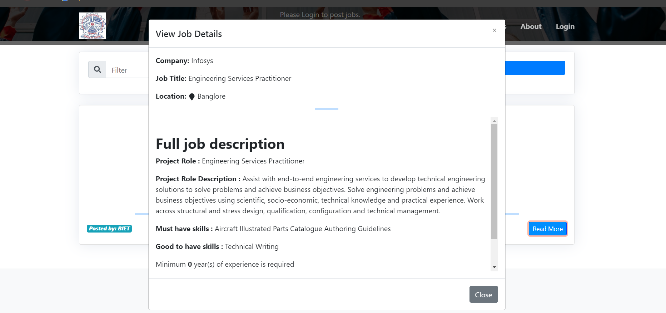
Fig: Admin Dashboard
Fig: Job Detail page

Slide 14
Learning Outcomes
Enhanced Proficiency: Gained hands-on experience with HTML, CSS, and ReactJS for frontend development.
Backend Development: Strengthened skills in SQL for server-side logic and database management.
Code Quality: Learned best practices for writing clean, maintainable code.
Addressing User Needs: Developed a platform that addresses the real-world challenge of connecting students with alumni.
Iterative Development: Engaged in iterative problem-solving, refining features based on user feedback and testing results.

Slide 15
Conclusion
The Departmental Alumni Network Platform effectively bridges the gap between current students and alumni, fostering guidance and job opportunities through a user-friendly interface and this platform also emphasizes the importance of hands-on experience in real-world applications. Engaging in projects like this fosters essential skills and encourages collaboration within the community. Ultimately, such initiatives enhance networking and strengthen professional relationships.

Slide 16




Thank you

